Slide 1
Transport networks（传输网）

Slide 2
Content
Application of digraph
Concept
  Capacity (容量)
  Transport network (传输网)
  Flow (流量)
  Virtual flow (虚流量)
  Maximal flow (最大流量)
Labeling algorithm (标记算法)
School of Computer Science, BUPT

Slide 3
Directed graph (Digraph)
An important use of labeled digraphs is to model what are commonly called transport networks.
The label on an edge represents the maximum flow that can be passed through that edge and is called the capacity（容量） of the edge. Many situations can be modeled in this way.
School of Computer Science, BUPT

Slide 4
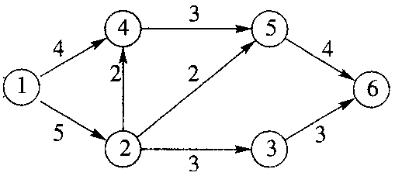
Example
Figure below might as easily represent an oil pipeline, a highway system, a communications network, or an electric power grid.
School of Computer Science, BUPT

Slide 5
Example
The vertices of a network are usually called nodes and may denote pumping stations, shipping depots, relay stations, or highway interchanges.
School of Computer Science, BUPT

Slide 6
Transport network
More formally, a transport network, or a network, is a connected digraph N with the following properties:
  There is a unique node, the source（源端）, that has in-degree 0. We generally label the source node l.
  There is a unique node, the sink（宿端）, that has out-degree 0. If N has n nodes, we generally label the sink as node n.
  The graph N is labeled. The label, C_{ij}, on edge (i, j) is a nonnegative number called the capacity of the edge.
School of Computer Science, BUPT

Slide 7
Flows
Mathematically, a flow（流量） in a network N is a function that assigns to each edge (i, j) of N a nonnegative number F_{ij} that does not exceed C_{ij}.
  Conservation of flow（流量守恒）
  Value of the flow
School of Computer Science, BUPT

Slide 8
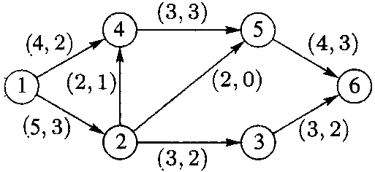
Flows
We can represent a flow F by labeling each edge (i, j) with the pair (C_{ij}, F_{ij})
Example 1
Here value(F) = 5
School of Computer Science, BUPT

Slide 9
Maximum Flows（最大流量）
For any network an important problem is to determine the maximum value of a flow through the network and to describe a flow that has the maximum value.
For obvious reasons this is commonly referred to the maximum flow problem.
School of Computer Science, BUPT

Slide 10
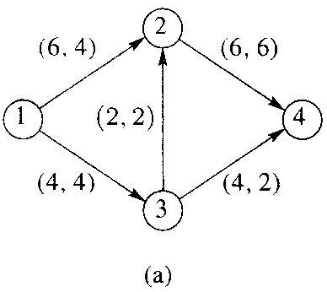
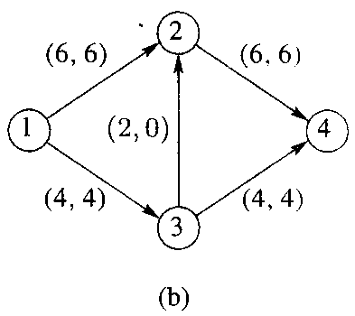
Example 2
Even for a small network, we need a systematic procedure for solving the maximum flow problem.
School of Computer Science, BUPT

Slide 11
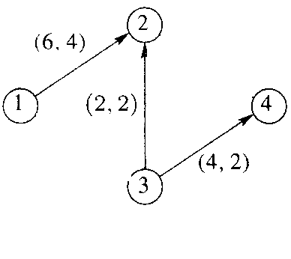
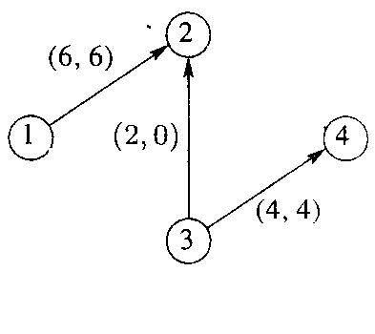
Virtual Flow
School of Computer Science, BUPT

Slide 12
Let N be a network and let G be the symmetric closure of N.
  Choose a path in G and let an edge (i,j) in this path.
  If (i,j)∈N and e_{ij}=C_{ij}-F_{ij}>0,then we say this edge has positive excess capacity（剩余容量）.
  If (i,j) is not an edge of N then we are traveling this edge in the wrong direction. In this case e_{ij}=F_{ji} if F_{ji} >0. Increasing flow through edge(i,j) will have the effect of reducing F_{ji}.
School of Computer Science, BUPT

Slide 13
A Maximum Flow Algorithm
The algorithm we present is due to Ford and Fulkerson and is often called the labeling algorithm（标记算法）.
The labeling referred to is an additional labeling of nodes.
We have used integer capacities for simplicity, but Ford and Fulkerson show that this algorithm will stop in a finite number of steps if the capacities are rational numbers.
School of Computer Science, BUPT

Slide 14
LABELING ALGORITHM
Let N be a network with n nodes and G be the symmetric closure of N. All edges and paths used are in G.
  Begin with all flows set to 0.
  As we proceed, it will be convenient to track the excess capacities in the edges and how they change rather than tracking the increasing flows.
  When the algorithm terminates, it is easy to find the maximum flow from the final excess capacities.
Example 3
School of Computer Science, BUPT

Slide 15
Step 1
Let N₁ be the set of all nodes connected to the source by an edge with positive excess capacity.
Label each j in N₁ with [E_{j}, l], where E_{j} is the excess capacity e_{1j} of edge (l, j).
The l in the label indicates that j is connected to the source, node l.
School of Computer Science, BUPT

Slide 16

Step 2
Let node j in N₁ be the node with smallest node number and let N₂(j) be the set of all unlabeled nodes, other than the source, that are joined to node j and have positive excess capacity.
Suppose that node k is in N₂(j) and (j, k) is the edge with positive excess capacity. Label node k with [E_{k}, j], where E_{k} is the minimum of E_{j} and the excess capacity e_{jk} of edge (j, k).
When all the nodes in N₂(j) are labeled in this way, repeat this process for the other nodes in N₁. Let
School of Computer Science, BUPT

Slide 17
Step 3
Repeat Step 2, labeling all previously unlabeled nodes N₃ that can be reached from a node in N₂ by an edge having positive excess capacity.
Continue this process forming sets N₄, N₅. . . . until after a finite number of steps either
  (i) the sink has not been labeled and no other nodes can be labeled. It can happen that no nodes have been labeled; remember that the source is not labeled. or
  (ii) the sink has been labeled.
School of Computer Science, BUPT

Slide 18
Step 4
In case (i), the algorithm terminates and the total flow then is a maximum flow.
  (i) the sink has not been labeled and no other nodes can be labeled. It can happen that no nodes have been labeled; remember that the source is not labeled.
School of Computer Science, BUPT

Slide 19
Step 5
In case (ii) the sink, node n, has been labeled with [E_{n}, m] where E_{n} is the amount of extra flow that can be made to reach the sink through a path π.
  (ii) the sink has been labeled.
School of Computer Science, BUPT

Slide 20
Step 5
We examine π in reverse order.
  If edge (i, j) ∈N, then we increase the flow in (i, j) by E_{n} and decrease the excess capacity e_{ij} by the same amount. Simultaneously, we increase the excess capacity of the (virtual) edge (j, i) by E_{n} since there is that much more flow in (i, j) to reverse.
  If, on the other hand, (i, j) ∉N, we decrease the flow in (j, i) by E_{n} and increase its excess capacity by E_{n}. We simultaneously decrease the excess capacity in (i, j) by the same amount, since there is less flow in (i, j) to reverse.
  We now have a new flow that is E_{n} units greater than before and we return to Step 1.
  Example 4
School of Computer Science, BUPT

Slide 21
Example 3
The initial flow in all edges is zero
e₄₅ = 3 e₅₄ = 0
e₅₆ = 4
e₆₅ = 0
4
5
e₁₄ = 4
e₄₁ = 0
1
e₂₄ = 2
e₄₂ = 0
e₂₅ = 2
e₅₂ = 0
6
e₁₂ = 5
e₂₁ = 0
e₃₆ = 3
e₆₃ = 0
2
3
e₂₃ = 3 e₃₂ = 0
School of Computer Science, BUPT

Slide 22
Example 3: step 1
  Starting at the source, we can reach nodes 2 and 4 by edges having excess capacity, so N₁= {2, 4}
[4,1]
e₄₅ = 3 e₅₄ = 0
e₅₆ = 4
e₆₅ = 0
4
5
e₁₄ = 4
e₄₁ = 0
1
e₂₄ = 2
e₄₂ = 0
e₂₅ = 2
e₅₂ = 0
6
e₁₂ = 5
e₂₁ = 0
e₃₆ = 3
e₆₃ = 0
2
3
e₂₃ = 3 e₃₂ = 0
[5,1]
School of Computer Science, BUPT

Slide 23
Example 3: step 2
  From node 2 we can reach nodes 5 and 3
  Label node 5 and node 3
  We cannot travel from node 4 to any unlabeled node by one edge. Thus, N₂ = {3, 5}
[4,1]
e₄₅ = 3 e₅₄ = 0
[2,2]
4
5
e₅₆ = 4
e₆₅ = 0
e₁₄ = 4
e₄₁ = 0
1
e₂₄ = 2
e₄₂ = 0
e₂₅ = 2
e₅₂ = 0
6
e₁₂ = 5
e₂₁ = 0
e₃₆ = 3
e₆₃ = 0
2
3
e₂₃ = 3 e₃₂ = 0
[5,1]
[3,2]
School of Computer Science, BUPT

Slide 24
Example 3: step 3
  We repeat Step 2 using N₂. We can reach the sink from node 3 and 3 units through edge (3, 6). Thus the sink is labeled with [3, 3]
[4,1]
e₄₅ = 3 e₅₄ = 0
[2,2]
4
5
e₅₆ = 4
e₆₅ = 0
e₁₄ = 4
e₄₁ = 0
1
e₂₄ = 2
e₄₂ = 0
e₂₅ = 2
e₅₂ = 0
6
[3,3]
e₁₂ = 5
e₂₁ = 0
e₃₆ = 3
e₆₃ = 0
2
3
e₂₃ = 3 e₃₂ = 0
[5,1]
[3,2]
School of Computer Science, BUPT

Slide 25
Example 3 : step 5
the path is l, 2, 3, 6
subtract 3 from the excess capacity of each edge, indicating an increased flow through that edge, and adding an equal amount to the excess capacities of the (virtual) edges.
School of Computer Science, BUPT

Slide 26
Example 3
We now return to Step l with the situation shown as
e₄₅ = 3 e₅₄ = 0
e₅₆ = 4
e₆₅ = 0
4
5
e₁₄ = 4
e₄₁ = 0
1
e₂₄ = 2
e₄₂ = 0
e₂₅ = 2
e₅₂ = 0
6
e₁₂ = 2
e₂₁ = 3
e₃₆ = 0
e₆₃ = 3
2
3
e₂₃ = 0 e₃₂ = 3
School of Computer Science, BUPT

Slide 27
Steps 1,2,3
[4,1]
e₄₅ = 3 e₅₄ = 0
[2,2]
4
5
e₅₆ = 4
e₆₅ = 0
e₁₄ = 4
e₄₁ = 0
1
e₂₄ = 2
e₄₂ = 0
e₂₅ = 2
e₅₂ = 0
6
[2,5]
e₁₂ = 2
e₂₁ = 3
e₃₆ = 0
e₆₃ = 3
2
3
e₂₃ = 0 e₃₂ = 3
[2,1]
School of Computer Science, BUPT

Slide 28
Step 5
  Work back along path 1,2,5,6, subtracting 2 from the excess capacities of these edges
  And return to Step 1.
e₄₅ = 3 e₅₄ = 0
e₅₆ = 2
e₆₅ = 2
4
5
e₁₄ = 4
e₄₁ = 0
1
e₂₄ = 2
e₄₂ = 0
e₂₅ = 0
e₅₂ = 2
6
e₁₂ = 0
e₂₁ = 5
e₃₆ = 0
e₆₃ = 3
2
3
e₂₃ = 0 e₃₂ = 3
School of Computer Science, BUPT

Slide 29
Step 1,2,3
[4,1]
e₄₅ = 3 e₅₄ = 0
[3,4]
4
5
e₅₆ = 2
e₆₅ = 2
e₁₄ = 4
e₄₁ = 0
1
e₂₄ = 2
e₄₂ = 0
e₂₅ = 0
e₅₂ = 2
6
[2,5]
e₁₂ = 0
e₂₁ = 5
e₃₆ = 0
e₆₃ = 3
2
3
e₂₃ = 0 e₃₂ = 3
[2,5]
School of Computer Science, BUPT

Slide 30
Step 5
  Work back along the path 1,4,5,6, adjusting excess capacities.
  Return to Step 1.
e₄₅ = 1 e₅₄ = 2
e₅₆ = 0
e₆₅ = 4
4
5
e₁₄ = 2
e₄₁ = 2
1
e₂₄ = 2
e₄₂ = 0
e₂₅ = 0
e₅₂ = 2
6
e₁₂ = 0
e₂₁ = 5
e₃₆ = 0
e₆₃ = 3
2
3
e₂₃ = 0 e₃₂ = 3
School of Computer Science, BUPT

Slide 31
Go further?
  Step 1,2,3
[2,1]
e₄₅ = 1 e₅₄ = 2
[1,4]
4
5
e₅₆ = 0
e₆₅ = 4
e₁₄ = 2
e₄₁ = 2
1
e₂₄ = 2
e₄₂ = 0
e₂₅ = 0
e₅₂ = 2
6
e₁₂ = 0
e₂₁ = 5
e₃₆ = 0
e₆₃ = 3
2
3
e₂₃ = 0 e₃₂ = 3
[1,5]
School of Computer Science, BUPT

Slide 32
step 4
  Terminated with the final overall flow 7.
      Q.E.D.
2
4
4
5
2
1
0
2
6
5
3
2
3
3
Go back
School of Computer Science, BUPT

Slide 33
Example 4
e₅₃ = 6 e₃₅ = 0
e₃₆ = 6
e₆₃ = 0
5
3
e₁₅ = 8
e₅₁ = 0
1
e₂₅= 2
e₅₂ = 0
e₂₃ = 3
e₃₂ = 0
6
e₁₂ = 5
e₂₁ = 0
e₄₆ = 7
e₆₄ = 0
2
4
e₂₄ = 4 e₄₂ = 0
School of Computer Science, BUPT

Slide 34
Step 1,2,3
[8,1]
[3,2]
e₅₃ = 6 e₃₅ = 0
e₃₆ = 6
e₆₃ = 0
5
3
e₁₅ = 8
e₅₁ = 0
[3,3]
1
e₂₅= 2
e₅₂ = 0
e₂₃ = 3
e₃₂ = 0
6
e₁₂ = 5
e₂₁ = 0
e₄₆ = 7
e₆₄ = 0
2
4
e₂₄ = 4 e₄₂ = 0
[5,1]
[4,2]
School of Computer Science, BUPT

Slide 35
Step 5
e₅₃ = 6 e₃₅ = 0
e₃₆ = 3
e₆₃ = 3
5
3
e₁₅ = 8
e₅₁ = 0
1
e₂₅= 2
e₅₂ = 0
e₂₃ = 0
e₃₂ = 3
6
e₁₂ = 2
e₂₁ = 3
e₄₆ = 7
e₆₄ = 0
2
4
e₂₄ = 4 e₄₂ = 0
School of Computer Science, BUPT

Slide 36
Step 1,2,3
[8,1]
e₅₃ = 6 e₃₅ = 0
[6,5]
5
3
e₃₆ = 3
e₆₃ = 3
e₁₅ = 8
e₅₁ = 0
[3,3]
1
e₂₅= 2
e₅₂ = 0
e₂₃ = 0
e₃₂ = 3
6
e₁₂ = 2
e₂₁ = 3
e₄₆ = 7
e₆₄ = 0
2
4
e₂₄ = 4 e₄₂ = 0
[2,1]
[2,2]
School of Computer Science, BUPT

Slide 37
Step 5
e₅₃ = 3 e₃₅ = 3
e₃₆ = 0
e₆₃ = 6
5
3
e₁₅ = 5
e₅₁ = 3
1
e₂₅= 2
e₅₂ = 0
e₂₃ = 0
e₃₂ = 3
6
e₁₂ =2
e₂₁ = 3
e₄₆ = 7
e₆₄ = 0
2
4
e₂₄ = 4 e₄₂ = 0
School of Computer Science, BUPT

Slide 38
Step 1,2,3
[5,1]
[3,5]
e₅₃ = 3 e₃₅ = 3
e₃₆ =0
e₆₃ =6
5
3
e₁₅ = 5
e₅₁ = 3
[2,4]
1
e₂₅= 2
e₅₂ = 0
e₂₃ = 0
e₃₂ = 3
6
e₁₂ =2
e₂₁ = 3
e₄₆ = 7
e₆₄ = 0
2
4
e₂₄ = 4 e₄₂ = 0
[2,1]
[2,2]
School of Computer Science, BUPT

Slide 39
Step 5
e₅₃ = 3 e₃₅ = 3
e₃₆ = 0
e₆₃ = 6
5
3
e₁₅ = 5
e₅₁ = 3
1
e₂₅= 2
e₅₂ = 0
e₂₃ = 0
e₃₂ = 3
6
e₁₂ =0
e₂₁ = 5
e₄₆ = 5
e₆₄ = 2
2
4
e₂₄ = 2 e₄₂ = 2
School of Computer Science, BUPT

Slide 40
Step 1,2,3
[5,1]
[3,5]
e₅₃ = 3 e₃₅ = 3
e₃₆ = 0
e₆₃ = 6
5
3
e₁₅ = 5
e₅₁ = 3
[2,4]
1
e₂₅= 2
e₅₂ = 0
e₂₃ = 0
e₃₂ = 3
6
e₁₂ =0
e₂₁ = 5
e₄₆ = 5
e₆₄ = 2
2
4
e₂₄ = 2 e₄₂ = 2
[3,3]
[2,2]
School of Computer Science, BUPT

Slide 41
Step 5
e₅₃ = 1 e₃₅ = 5
e₃₆ = 0
e₆₃ = 6
5
3
e₁₅ = 3
e₅₁ = 5
1
e₂₅= 2
e₅₂ = 0
e₂₃ = 2
e₃₂ = 1
6
e₁₂ =0
e₂₁ = 5
e₄₆ = 3
e₆₄ = 4
2
4
e₂₄ = 0 e₄₂ = 4
School of Computer Science, BUPT

Slide 42
Go further?
Step 1,2,3
[3,1]
e₅₃ = 1 e₃₅ = 5
[1,5]
5
3
e₃₆ = 0
e₆₃ = 6
e₁₅ = 3
e₅₁ = 5
1
e₂₅= 2
e₅₂ = 0
e₂₃ = 2
e₃₂ = 1
6
e₁₂ =0
e₂₁ = 5
e₄₆ = 3
e₆₄ = 4
2
4
e₂₄ = 0 e₄₂ = 4
[1,3]
School of Computer Science, BUPT

Slide 43
Step 4
e₅₃ = 1 e₃₅ = 5
e₃₆ = 0
e₆₃ = 6
5
3
e₁₅ = 3
e₅₁ = 5
1
e₂₅= 2
e₅₂ = 0
e₂₃ = 2
e₃₂ = 1
6
e₁₂ =0
e₂₁ = 5
e₄₆ = 3
e₆₄ = 4
2
4
e₂₄ = 0 e₄₂ = 4
School of Computer Science, BUPT

Slide 44
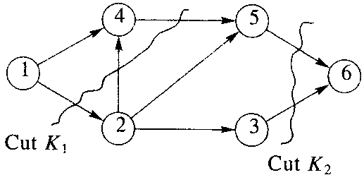
Cut（割集）
A cut in a network N is a set K of edges having the property that every path from the source to the sink contains at least one edge from K.
School of Computer Science, BUPT

Slide 45
Capacity of a cut K
The capacity of a cut K, c(K), is the sum of the capacities of all edges in K.
If F is any flow and K is any cut, then
  value(F)  c(K).
    all parts of F must pass through the edges of K, and c(K) is the maximum amount that can pass through the edges of K.
    value(F)=c(K);the flow F uses the full capacity of all edges in K.Then F wouid be a flow with maximum value, since no flow can have value bigger than c(K).
    K must be a minimum capacity cut,bccause every cut must have capacity at least equal to value(F).
School of Computer Science, BUPT

Slide 46
Theorem
A maximum flow F in a network has value equal to the capacity of a minimum cut of the network.
School of Computer Science, BUPT

Slide 47
Basic concepts
Transport Networks digraphs whose edges labeled with capacities.
Source
Sink
Super source(超源)
Super sink(超宿(汇))
Flows conservation of flow (C_{ij},F_{ij})
Maximum flows virtual flow

Slide 48
Example
1
2
2
4
6
3
4
2
2
2
5
7
3
3
4

Slide 49
Supersource supersink
1
2
2
4
6
11
11
3
4
a
11
2
2
b
2
11
11
5
7
3
3
4

Slide 50
[11,a]
1
e₁₄ = 2 e₄₁ = 0
[2,1]
[2,4]
e₄₆ = 2 e₆₄ = 0
4
6
e _{6b}= 11 e_{b6}= 0
11
[11,a]
3
[2,6]
a
2
2
4
b
11
2
11
11
[11,a]
5
7
3
3
4
[2,2]
[2,5]

Slide 51
[9,a]
e₁₄ = 0 e₄₁ = 2
[2,5]
1
1
[3,2]
e₄₆ = 0 e₆₄ = 2
4
e _{6b}= 9 e_{b6}= 2
4
6
6
9
[11,a]
[2,6]
3
3
4
a
a
2
2
2
2
b
11
b
11
2
2
11
11
11
11
[11,a]
5
5
7
7
3
3
3
3
4
[2,2]
[2,5]
4

Slide 52
[9,a]
1
e₁₄ = 0 e₄₁ = 2
[3,2]
[2,5]
e₄₆ = 0 e₆₄ = 2
4
6
e _{6b}= 7 e_{b6}= 4
9
[9,a]
e₅₆ = 2 e₆₅ = 2
3
a
9
2
2
b
[2,6]
e₂₅ = 0 e₅₂ = 2
11
11
[11,a]
5
7
3
3
4
[4,3]
[3,5]

Slide 53
[9,a]
1
e₁₄ = 0 e₄₁ = 2
[3,2]
e₄₆ = 0 e₆₄ = 2
4
6
e _{6b}= 5 e_{b6}= 6
9
[9,a]
e₅₆ = 0 e₆₅ =4
3
a
9
2
2
b
[2,7]
e₂₅ = 0 e₅₂ = 2
9
11
[9,a]
e₃₄ = 2 e₄₃ = 2
5
7
3
3
[2,3]
[2,5]

Slide 54
[9,a]
1
e₁₄ = 0 e₄₁ = 2
[3,2]
e₄₆ = 0 e₆₄ = 2
4
6
e _{6b}= 5 e_{b6}= 6
9
[9,a]
e₅₆ = 0 e₆₅ =4
3
a
9
2
2
b
[1,7]
e₂₅ = 0 e₅₂ = 2
e _{7b}= 9 e_{b7}= 2
7
[7,a]
e₃₄ = 0 e₄₃ = 4
5
7
3
e₅₇= 1 e₇₅ =2
[2,4]
[1,5]

Slide 55
[9,a]
1
e₁₄ = 0 e₄₁ = 2
[2,2]
e₄₆ = 0 e₆₄ = 2
4
6
e _{6b}= 5 e_{b6}= 6
9
e₂₄ = 2 e₄₂ = 1
[8,a]
e₅₆ = 0 e₆₅ =4
a
2
e₄₅ = 1 e₅₄ = 1
b
8
e₂₅ = 0 e₅₂ = 2
e _{7b}= 8 e_{b7}= 3
7
[7,a]
e₃₄ = 0 e₄₃ = 4
5
7
3
e₅₇= 0 e₇₅ =3
[1,4]

Slide 56
stop
[9,a]
(2,2)
[2,2]
1
e₁₄ = 0 e₄₁ = 2
e₄₆ = 0 e₆₄ = 2
(2,2)
4
6
e _{6b}= 5 e_{b6}= 6
9
[8,a]
e₂₄ = 2 e₄₂ = 1
(3,1)
(2,1)
e₄₅ = 1 e₅₄ = 1
a
8
2
e₅₆= 0 e₆₅ = 4
b
e₂₅ = 0 e₅₂ = 2
(4,4)
(2,2)
7
[7,a]
e_{7b} = 8 e_{b7}= 3
5
7
3
(4,4)
e₅₇ = 0 e₇₅ = 3
(3,3)
e₃₅ = 0 e₅₃ = 4
[1,4]

Slide 57
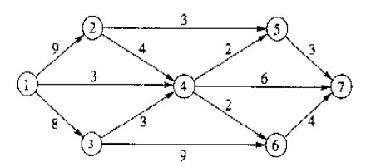
Find the maximal flow for the network N given in Figure 1.
Figure 1

